Slide 1
2D Graphics Introduction
Dr. Lathsamy Chidtavong
Mobile No.77712077
Email: l.chidtavong@nuol.edu.la
Link: https://www.w3schools.com/graphics/svg_rect.asp

Slide 2
ປະເພດຂອງຮູບພາບດິຈິຕອນ
ແບບ Raster ຫຼື ແບບບິດແມັບ (Bitmap Image)
ແບບ Vector (Vector Image)

Slide 3
ຮູບພາບແບບບິດແມັບ (Bitmap Image)
ເປັນພາບທີ່ປະກອບຂື້ນຈາກຈຸດ (ເມັດ) ນ້ອຍໆ ທີ່ເອີ້ນວ່າຟິກເຊວຈຳນວນຫຼາຍທີ່ຮຽນຕໍ່ກັນຈົນເປັນໜຶ່ງພາບ.
ພາບແບບບິດແມັບນີ້ຈະມີຈຳນວນຈຸດຂະໜາດນ້ອຍໆ ຈຳນວນຫຼາຍ, ດັ່ງນັ້ນຕາຂອງມະນຸດບໍ່ສາມາດທີ່ຈະແນມເຫັນ ແລະຈຳແນກລາຍລະອຽດສ່ວນຍ່ອຍນ້ອຍໆນັ້ນໄດ້.
ແຕ່ເມື່ອລອງຂະຫຍາຍພາບເບິ່ງຈະເຫັນເປັນຮູບຕາຕະລາງ ຍິ່ງຂະຫຍາຍໃຫ່ຍເທົ່າໃດ ຕາຕະລາງສີ່ຫຼ່ຽມກໍ່ຍິ່ງມີຂະໜາດໃຫ່ຍຂື້ນ ຈົນເຮັດໃຫ້ແນມເຫັນຈຸດຂອງພາບ ຫຼືຟິກເຊວ ຈຶງມີຜົນເຮັດໃຫ້ລາຍລະອຽດຂອງພາບມີຄວາມບໍ່ຊັດເຈນຫຼາຍຂື້ນ.

Slide 4
ຮູບພາບແບບເວັກເຕີ (Vector Image)
ຮູບພາບແບບເວັກເຕີຈະມີຄຸນສົມບັດແຕກຕ່າງກັບແບບບິດແມັບຄື: ພາບປະເພດນີ້ບໍ່ວ່າຈະຂະຫຍາຍໃຫ່ຍເທົ່າໃດ ກໍ່ຍັງຄົງລາຍລະອຽດ ແລະຄວາມຄົມຊັດໄວ້ໄດ້ດັ່ງເດີມແບບບໍ່ມີບ່ອນຜິດພ້ຽນ.
ເນື່ອງຈາກວ່າພາບແບບເວັກເຕີນັ້ນປະກອບດ້ວຍເສັ້ນຊື່, ເສັ້ນໂຄ້ງ ແລະ ຮູບຊົງເລຂາຄະນິດຕ່າງໆ. ພາບທີ່ໄດ້ຈະສ້າງຂື້ນຈາກຄຳສັ່ງທີ່ບອກເຖິງລັກສະນະຂອງພາບໃນຮູບແບບທາງເລຂາຄະນິດດ້ວຍສົມຜົນທາງຄະນິດສາດ.
ດັ່ງນັ້ນ, ໂປຼແກຼມທີ່ຕ້ອງການເປີດຮູບພາບຈະຕ້ອງເອົາສົມຜົນຕ່າງໆທີ່ບັນທຶກເອົາໄວ້ ມາຄຳນວນ ແລະສ້າງຮູບຊົງຂອງພາບຂື້ນມາໃໝ່.
ຈຸດເດັ່ນຄື: ບໍ່ວ່າຈະຂະຫຍາຍພາບໃຫ້ໃຫ່ຍເທົ່າໃດ ຄອມພິວເຕີກໍ່ຈະຄຳນວນຄ່າຕ່າງໆ ໃຫ້ໃໝ່ທຸກຄັ້ງ ເຮັດໃຫ້ພາບທີ່ເກີດຂື້ນມາມີຄວາມຄົມຊັດ.

Slide 5
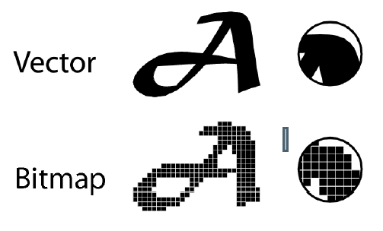
ຕົວຢ່າງຂະຫຍາຍຮູບພາບທັງສອງແບບ

Slide 6
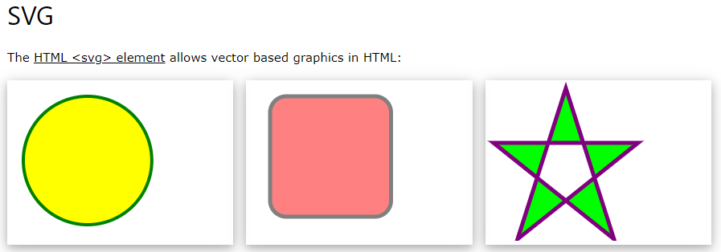
HTML Graphics

Slide 7
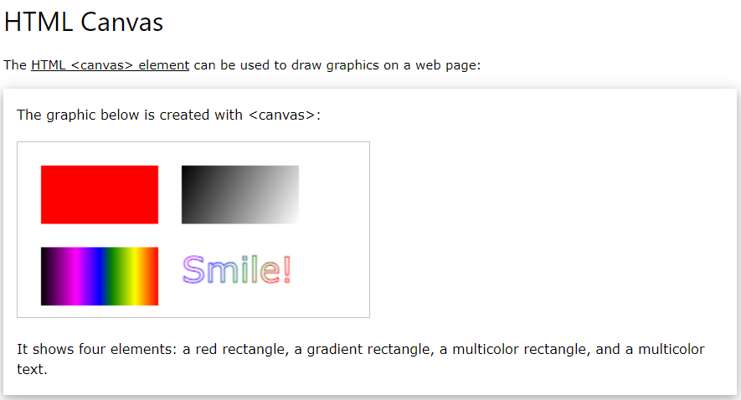
HTML Graphics

Slide 8
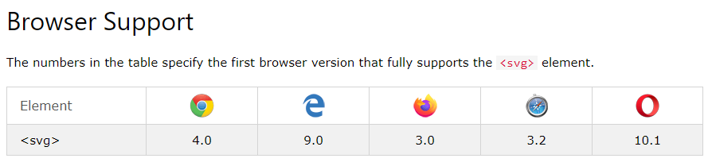
HTML SVG Graphics
What is SVG?
SVG stands for Scalable Vector Graphics
SVG is used to define graphics for the Web
SVG is a W3C recommendation
The HTML <svg> Element
The HTML <svg> element is a container for SVG graphics.
SVG has several methods for drawing paths, boxes, circles, text, and graphic images.

Slide 9
HTML SVG Graphics
SVG Shapes : SVG has some predefined shape elements that can be used by developers:
Rectangle <rect>
Circle <circle>
Ellipse <ellipse>
Line <line>
Polyline <polyline>
Polygon <polygon>
Path <path>

Slide 10
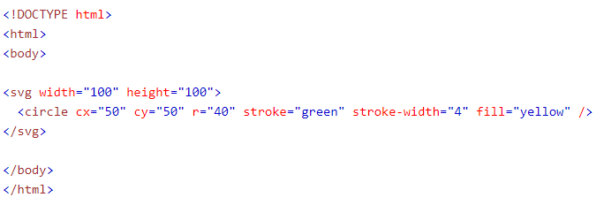
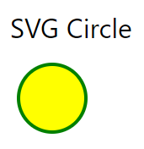
HTML SVG Graphics

Slide 11
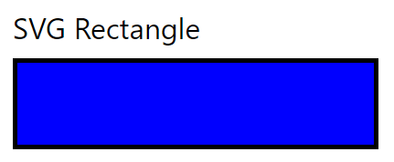
HTML SVG Graphics

Slide 12
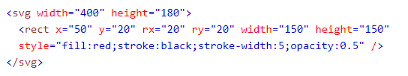
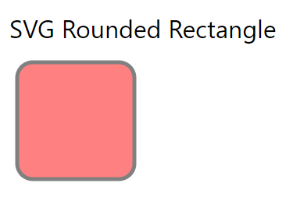
HTML SVG Graphics

Slide 13
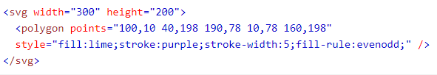
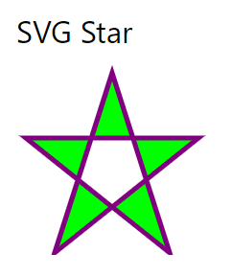
HTML SVG Graphics

Slide 14
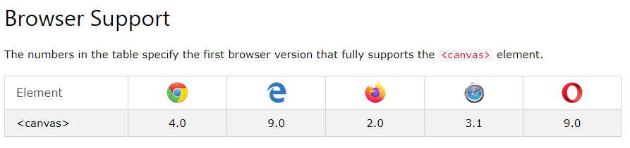
HTML Canvas Graphics
The HTML <canvas> element is used to draw graphics, on the fly, via JavaScript.
The <canvas> element is only a container for graphics. You must use JavaScript to actually draw the graphics.
Canvas has several methods for drawing paths, boxes, circles, text, and adding images.

Slide 15
HTML Canvas Graphics
HTML Canvas Can Draw Text
Canvas can draw colorful text, with or without animation.
HTML Canvas Can Draw Graphics
Canvas has great features for graphical data presentation with an imagery of graphs and charts.
HTML Canvas Can be Animated
Canvas objects can move. Everything is possible: from simple bouncing balls to complex animations.
HTML Canvas Can be Interactive
Canvas can respond to JavaScript events.
Canvas can respond to any user action (key clicks, mouse clicks, button clicks, finger movement).
HTML Canvas Can be Used in Games
Canvas' methods for animations, offer a lot of possibilities for HTML gaming applications.

Slide 16
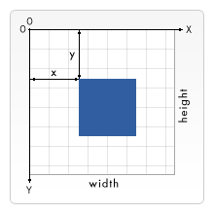
HTML Canvas Coordinates
Canvas Coordinates
The HTML canvas is a two-dimensional grid.
The upper-left corner of the canvas has the coordinates (0,0)

Slide 17
HTML Canvas Graphics
Draw a Line
To draw a straight line on a canvas, use the following methods:
moveTo(x,y) - defines the starting point of the line
lineTo(x,y) - defines the ending point of the line
To actually draw the line, you must use one of the "ink" methods, like stroke().

Slide 18
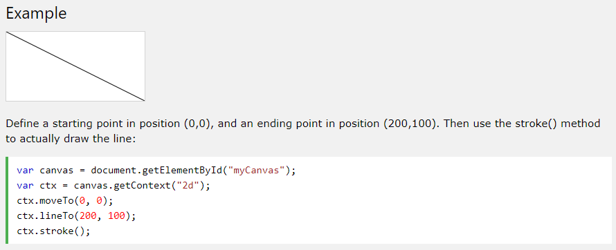
HTML Canvas Graphics

Slide 19
HTML Canvas Graphics
Draw a Circle
To draw a circle on a canvas, use the following methods:
beginPath() - begins a path
arc(x,y,r,startangle,endangle) - creates an arc/curve. To create a circle with arc(): Set start angle to 0 and end angle to 2*Math.PI.
The x and y parameters define the x- and y-coordinates of the center of the circle. The r parameter defines the radius of the circle.

Slide 20
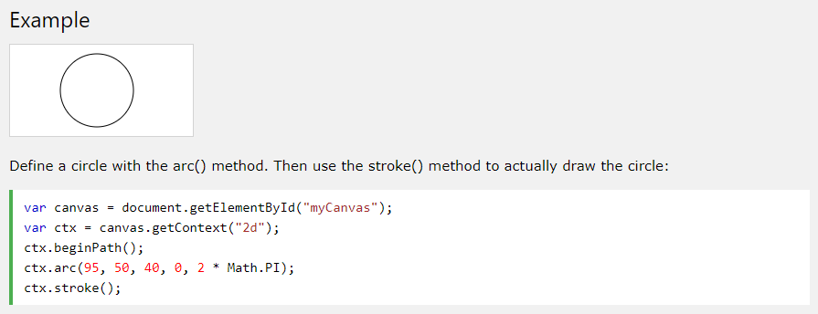
HTML Canvas Graphics

Slide 21
HTML Canvas Graphics
Drawing Text on the Canvas
To draw text on a canvas, the most important property and methods are:
font - defines the font properties for the text
fillText(text,x,y) - draws "filled" text on the canvas
strokeText(text,x,y) - draws text on the canvas (no fill)

Slide 22
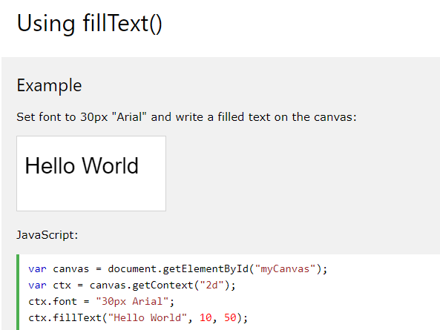
HTML Canvas Graphics

Slide 23
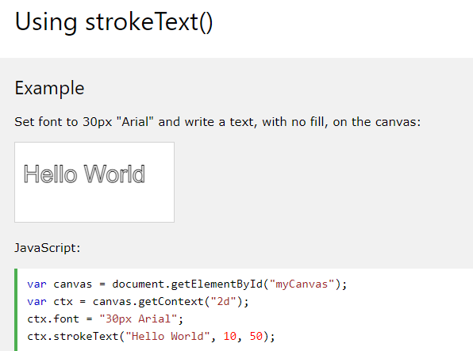
HTML Canvas Graphics

Slide 24
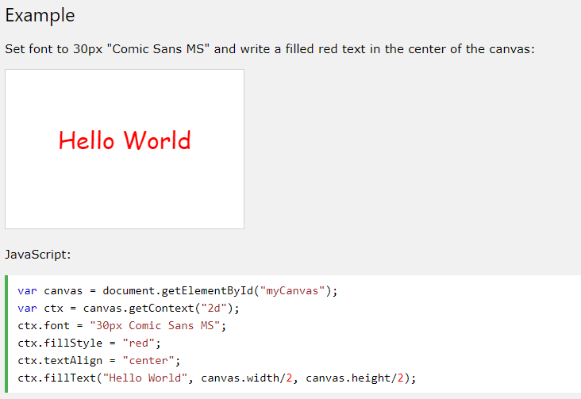
HTML Canvas Graphics
Add Color and Center Text

Slide 25
HTML Canvas Images
Canvas – Images: To draw an image on a canvas, use the following method:
drawImage(image,x,y)

Slide 26
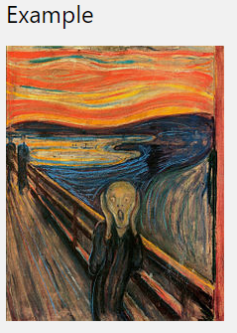
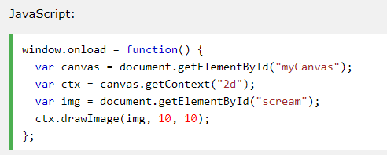
HTML Canvas Images

Slide 27
Drawing shapes with canvas
<canvas> only supports two primitive shapes: rectangles and paths (lists of points connected by lines). All other shapes must be created by combining one or more paths.
Drawing rectangles
There are three functions that draw rectangles on the canvas:
fillRect(x, y, width, height) Draws a filled rectangle.
strokeRect(x, y, width, height) Draws a rectangular outline.
clearRect(x, y, width, height) Clears the specified rectangular area, making it fully transparent.
Each of these three functions takes the same parameters. x and y specify the position on the canvas (relative to the origin) of the top-left corner of the rectangle. width and height provide the rectangle's size

Slide 28
The script includes a function called draw(), which is executed once the page finishes loading; this is done by listening for the load event on the document

Slide 29
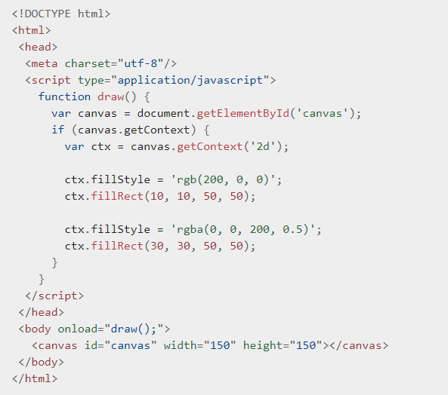
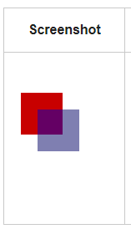

Slide 30

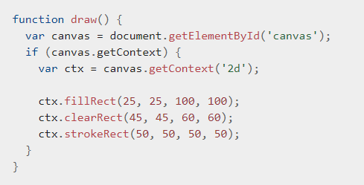
Drawing shapes with canvas
The fillRect() function draws a large black square 100 pixels on each side.
The clearRect() function then erases a 60x60 pixel square from the center,
and then strokeRect() is called to create a rectangular outline 50x50 pixels within the cleared square.

Slide 31
Drawing paths
A path is a list of points, connected by segments of lines that can be of different shapes, curved or not, of different width and of different color. A path, or even a subpath, can be closed. To make shapes using paths, we take some extra steps:
First, you create the path.
Then you use drawing commands to draw into the path.
Once the path has been created, you can stroke or fill the path to render it.

Slide 32
Drawing paths
beginPath() Creates a new path. Once created, future drawing commands are directed into the path and used to build the path up.
closePath() Adds a straight line to the path, going to the start of the current sub-path.
stroke() Draws the shape by stroking its outline.
fill() Draws a solid shape by filling the path's content area.
The first step to create a path is to call the beginPath(). Internally, paths are stored as a list of sub-paths (lines, arcs, etc) which together form a shape.

Slide 33
Drawing paths
The second step is calling the methods that actually specify the paths to be drawn.
The third, and an optional step, is to call closePath(). This method tries to close the shape by drawing a straight line from the current point to the start. If the shape has already been closed or there's only one point in the list, this function does nothing.
Note: When you call fill(), any open shapes are closed automatically, so you don't have to call closePath(). This is not the case when you call stroke()

Slide 34
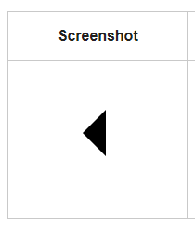
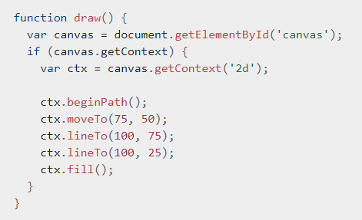
Drawing a triangle

Slide 35
Differences Between SVG and Canvas
SVG is a language for describing 2D graphics in XML.
Canvas draws 2D graphics, on the fly (with a JavaScript).
SVG is XML based, which means that every element is available within the SVG DOM (Document Object Model). You can attach JavaScript event handlers for an element.
In SVG, each drawn shape is remembered as an object. If attributes of an SVG object are changed, the browser can automatically re-render the shape.
Canvas is rendered pixel by pixel. In canvas, once the graphic is drawn, it is forgotten by the browser. If its position should be changed, the entire scene needs to be redrawn, including any objects that might have been covered by the graphic.
Notes:
The document object model (DOM) is a representation of web documents as connected objects that you can manipulate with JavaScript. SVG documents in web browsers support the core DOM methods defined for all XML and HTML elements.

Slide 36
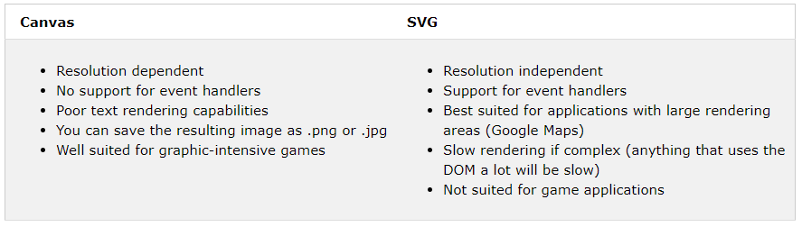
Comparison of Canvas and SVG

